Slide 1
SQL Operators

Slide 2
Types of operators
Operators are used to specify conditions in SQL statement.
An operator works on data items in order to return desired results.
These data items are called operands or arguments.
SQL operators are grouped under 5 types
Arithmetic Operators
Character Operators
Logical Operators
Comparison Operators
Set Operators

Slide 3
Arithmetic operators
Arithmetic operators works on Numeric operands.
They are Add (+), - (Subtract), * (Multiply), %(Divide)
The result is always an integer.
When the operators works on a single operand they are called Unary operators.
Ex: -234, +56
When the operators works on two operands they are known as Binary operators.
Ex. 6+3, 90/10
+ and – operators works on Date arithmetic.
Parentheses can be used to override precedence.

Slide 4
Examples
SELECT 5 + 10.5 FROM DUAL;
SELECT -12 + 8 FROM DUAL;
SELECT qty * price FROM Product;
SELECT bill_amt / 10 FROM orders;
SELECT sysdate + 7 FROM DUAL;
Sysdate returns the current system date.

Slide 5
Activity
Find out what the following query returns?
SQL> SELECT sysdate + 7 FROM DUAL;
SQL> SELECT sysdate – 35 FROM DUAL;
SQL> SELECT sysdate * 2 FROM DUAL;

Slide 6
Character operators
Character operators works on character strings.
Concatenation operator is used to join two character strings
Vertical bars(||) are used fro concatenation.
When we concatenate two null strings, the result is always NULL.
When we concatenate a zero-length string with another string, the result is the character string
Example:
SQL> SELECT ‘HELLO’||’ ‘||’ORACLE’ FROM DUAL;
Output: HELLO ORACLE

Slide 7
Comparison operators
Comparison operators are used to compare two values or expressions.
The result is a Boolean value either TRUE, FALSE or NULL.
The comparison operators are
Operator | Purpose
= | Equality sign
!= , <> | Not Equal to
> | Greater than
< | Less than
>= | Greater than or equal to
<= | Less than or equal to

Slide 8
Examples
Consider the Product table which we created earlier with the records
Get the details of the product whose price is less than 400
SELECT pid,pname,qty FROM product WHERE price<400;
Get the order number and the customer number for orders after year 2010.
SELECT ORDER_NUMBER, CUST_NUMBER FROM Orders WHERE ORDER_DATE>'31-DEC-2010';
Get all the details of the products excluding the prodname ‘Skirt’.
SELECT * FROM product WHERE pname!= ‘Skirt’;
Notes:
Add some more data :
INSERT INTO Orders VALUES(2000,100,'7-JAN-2011',1600);
INSERT INTO Orders VALUES(2001,200,'10-JMAR-2011',2300);
INSERT INTO Orders VALUES(2003,300,'10-JUL-2012',2000);
INSERT INTO Items VALUES(2000,4,1,1000);
INSERT INTO Items VALUES(2000,1,1,600);
INSERT INTO Items VALUES(2001,4,2,1000);
INSERT INTO Items VALUES(2001,2,1,300);
INSERT INTO Items VALUES(2003,4,2,1000);

Slide 9
IN operator
IN operator is allows us to test whether the given value is in the given set of values.
Syntax:
SELECT column_name1[,column_name2…] FROM
table_name WHERE column_name [NOT] IN
(column1[,column2…]);
The values specified are checked and compared with the list of values in the IN phrase.
NOT operator with the IN phrase is used to test for a value that is not in the list of values.
IN operator allows to specify multiple values in a WHERE clause.

Slide 10
Example
Get the product Id, names and price from the product whose
product names are Kurti and Shirt.
SELECT pid,pname,price FROM product WHERE pname IN ('T-Shirt','Shirt');
Get all the details from the product whose pid ’s are not 5 & 2.
SELECT * FROM product WHERE pid NOT IN (5,2);

Slide 11
LIKE operator
LIKE operator allows us to search for a specified pattern in a column.
This is useful when we don’t know the entire value to match the pattern.
Search conditions can either be numbers or characters.
For this purpose we use Wild card characters like %, _
Wild Character % is used to match zero or more characters.
Wild Character _ is used to match a single character.
ESCAPE is used to interpret % or _ literally, rather than special characters.
IS NULL is used to test for NULL values

Slide 12
Example
Find the Pid, names whose names are beginning with ‘S’
SELECT pid, pname FROM product WHERE pname LIKE ‘%S%’;
Find all the product names that has a pattern with irt.
SELECT * FROM product WHERE pname LIKE ‘__irt’;
Find all the products where the product name does not contain the
letters ‘rt’.
SELECT * FROM product WHERE pname NOT LIKE ‘%irt’;

Slide 13
BETWEEN Operators
BETWEEN and AND operators are used to compare data within the specified range.
Example:
Find all of the order dates from orders which took place from
1st January to 30th April 2011.
SELECT * FROM Orders WHERE order_date BETWEEN ‘01-JAN-2011’ AND ’30-APR-2011’;
Find the order numbers whose bill amount are not in the range from
2000 to 3000.
SELECT order_number FROM orders WHERE bill_amt NOT BETWEEN 2000 AND 3000;

Slide 14
Logical Operators
Logical operators are used to combine the results of two comparison conditions.
The result is a Boolean value either TRUE or FALSE.
They are AND,OR,NOT
Operator | Purpose
AND | Returns TRUE if both the component conditions are TRUE
OR | Returns TRUE if either of the component condition is TRUE
NOT | Returns TRUE if the condition is FALSE

Slide 15
Examples
Display all the details from items whose order number starts with 1 or product id is 4.
SELECT * FROM items WHERE order_number LIKE ‘ 1%’ OR pid=4;
Display all the details from items whose order number starts with 1 and product id is 4.
SELECT * FROM items WHERE order_number like ‘1%’ AND pid=4;
Find all the details of the products whose price is less than 500 and their product name is not null.
SELECT * FROM product WHERE price<500 AND
pname NOT NULL;

Slide 16
Exercises
Write query to get the following details from the Salary_det table:
Update the data with the new basic to be 10% more than the current basic.
Display the details of the employees who name begin with alphabet between ‘A/a’ or ‘H/h’ .
List the details of the female employees who have joined after JUNE 2009.
Count the number of employees who have ID as beginning with ‘SAP’
Get all IDs of the employees whose have taken casual leave for more than 3 days at a stretch.
Get the leave details for the employees EA12345 and EA23456.
(30 mins)

Slide 17
SET Operators
SET operators are used to combine the results of two or more queries to generate a single result set.
This is known as Compound query.
The number of columns selected in both queries must be the same.
The various Set operators are
UNION
UNION ALL
INTERSECT
MINUS

Slide 18
UNION
The UNION operator returns all rows selected by the either query.
The number of columns and data type of the columns being selected must be identical in all the SELECT statements used in the query.
Null values are not ignored.
By default the output is stored in the ascending order of the first column of the select clause.
The result returns only the distinct rows and no duplicate rows.

Slide 19
Example
Let us create a new table Product_Old with the following details.
Product_Old
PID | NAME | QTY | UNIT_PRICE
11 | Jacket | 10 | 2000
2 | T-Shirt | 10 | 300
12 | Hanky | 5 | 25
4 | Trouser | 20 | 900
5 | Skirt | 10 | 200
Display the product names and prices of all the products from both the tables. Display each product Id only once.
SQL> SELECT pid, pname FROM product
UNION
SELECT pid, name FROM product_old;
Notes:
Product_Old table set up
CREATE TABLE Product_Old(PID number(4), Name varchar2(30), Qty number(2), Unit_Price NUMBER(6,2));
INSERT INTO Product_Old VALUES(11,'Jacket',10,2000);
INSERT INTO Product_Old VALUES(2,'T-Shirt',10,300);
INSERT INTO Product_Old VALUES(12,'Hanky',5,25);
INSERT INTO Product_Old VALUES(4,'Trousers',20,900);
INSERT INTO Product_Old VALUES(5,'Skirt',10,200);

Slide 20
UNION ALL
UNION ALL operator to returns all rows from either query.
Duplicate rows are not eliminated..
Example:
Display all the product id and their names from both the tables.
SQL> SELECT pid,pname FROM product
UNION ALL
SELECT pid,name FROM product_old;

Slide 21
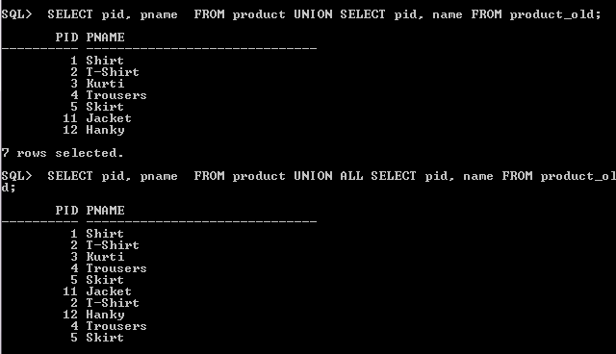
Comparison

Slide 22
INTERSECT
INTERSECT operator to returns distinct rows that are returned by both the queries.
The number of columns and data type of the columns being selected must be identical in all the SELECT statements used in the query.
Reversing the order of intersected table does not alter the result .
It does not ignore null values .
Example:
Display all the product Id and their names common to both tables.
SQL> SELECT pid,pname FROM product
INTERSECT
SELECT pid,name FROM product_old;
d;

Slide 23
MINUS
MINUS operator returns the distinct rows that are returned by the first query but not returned by the second query.
It gives the result of first select statement MINUS the result of second select statement .
The number of columns and data type of the columns being selected must be the same.
Example:
SQL> SELECT pid,pname FROM product
MINUS
SELECT pid,name FROM product_old;

Slide 24
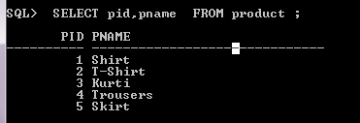
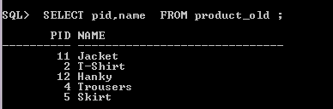


What if you exchange the sequence of the SELECT statements? Will the result be same?

Slide 25
Operator precedence
Using parentheses changes the order of Precedence
Operators with same precedence are evaluated from left to right.
All Set operators have equal precedence.
Evaluation order | Operators
1 | Unary operators +, -
2 | Multiplication, Division * , /
3 | Add, Subtraction, Concatenation +,-,||
4 | Comparison operators =, !=, >,<,>=,<=, IS NULL, Like, IN, Between
5 | Logical operator NOT
6 | Logical operator AND
7 | Logical operator OR

Slide 26
Exercise
Create another table Salary_Old with the following records.
Sapid | Ename | Gender | DName
EA12345 | Geetha S | F | Sales
SAP1234 | Mohan V | M | Sales
SAP2345 | Sudha N | F | HR
ES4098 | Rahul | M | Testing
SEM7132 | Vijay R | M | Payroll
Display sapids and names from both the tables with no duplicates.
Display sapid of all female employees from both the tables.
Using the information available in both the tables find sapids of all the employees who have joined after 2009 but not in HR department.
Display sapids and names in the form of “<<name>>(<<sapid>>) who are only in Salary_Det table. (45 mins)

